Slide 1
UNIT-IV
Syllabus: Task communication of RTOS, Shared memory, pipes, memory mapped objects, message passing, message queue, mailbox, signaling, RPC and sockets, task communication/synchronization issues, racing, deadlock, live lock, the dining philosopher’s problem.
Course Outcome :
Analyze various communication mechanisms for inter process communication in real time operating systems.

Slide 2

What is task communication ?
Types of task processes based on communication .
    Co-Operating Processes
    Competing Processes

Slide 3
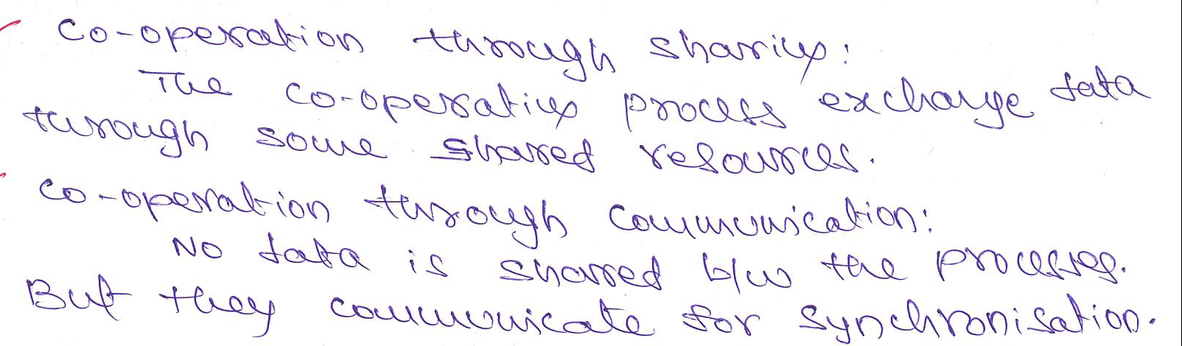
Co-Operating Processes

Slide 4
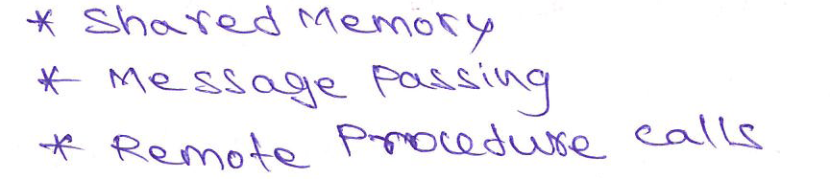
What is IPC ?
IPC Mechanisms

Slide 5
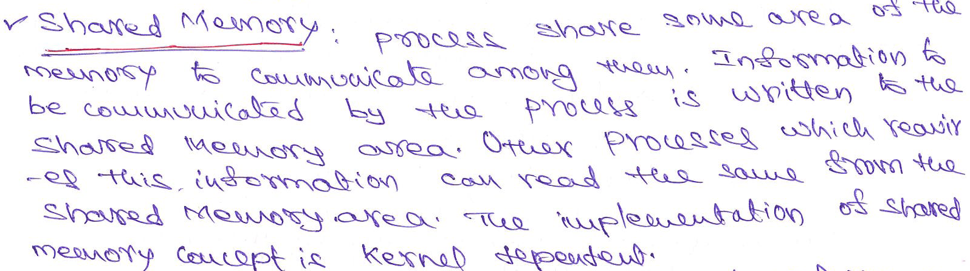
IPC

Slide 6

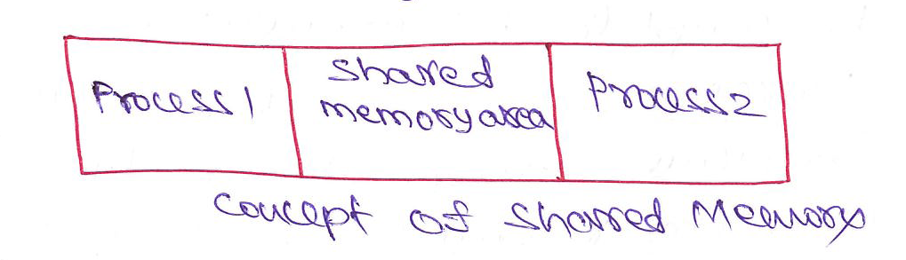
Shared Memory

Slide 7
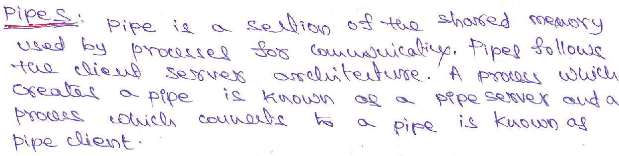
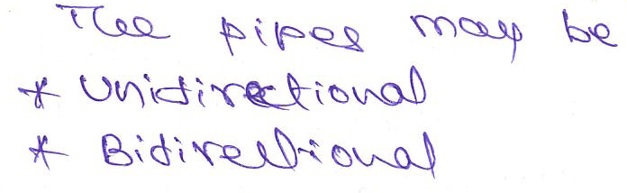

Slide 8

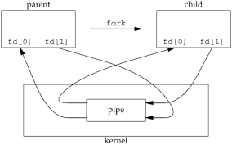
Pipes
Unidirectional Pipe :
Bidirectional Pipe :

Slide 9

Pipes

Slide 10
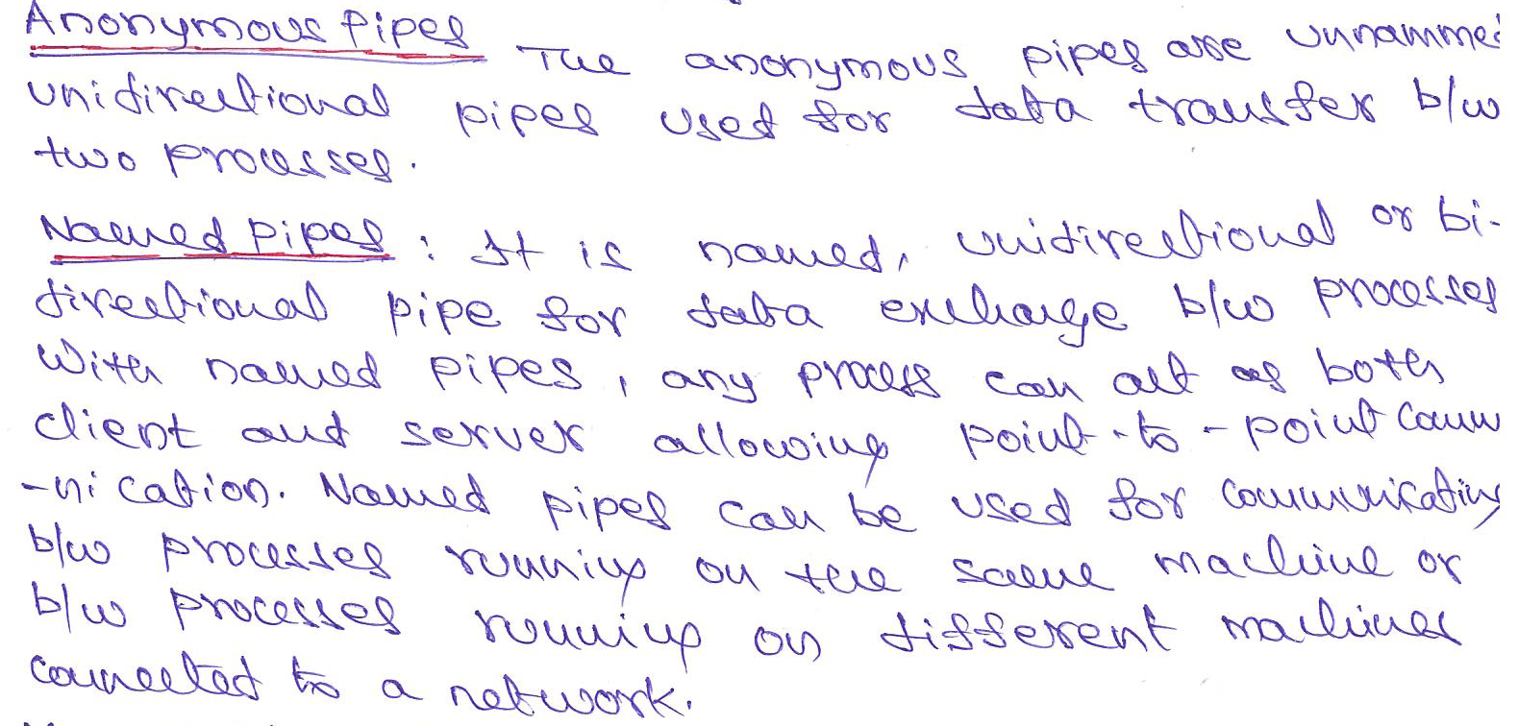

Slide 11
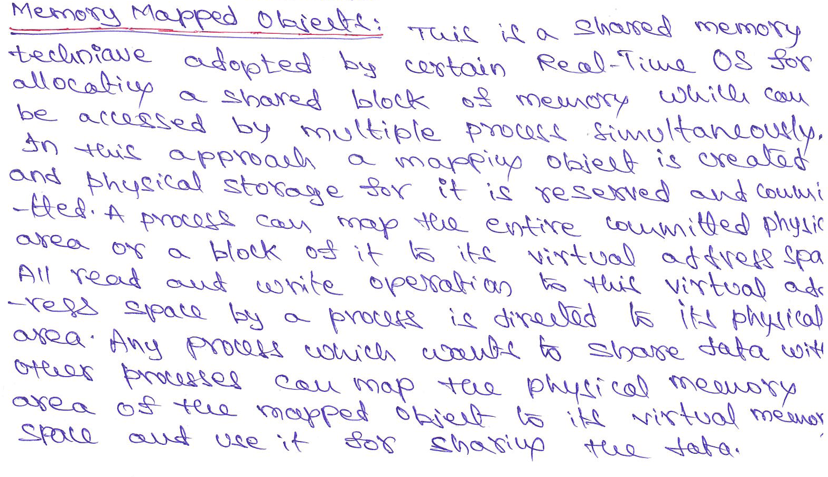

Slide 12
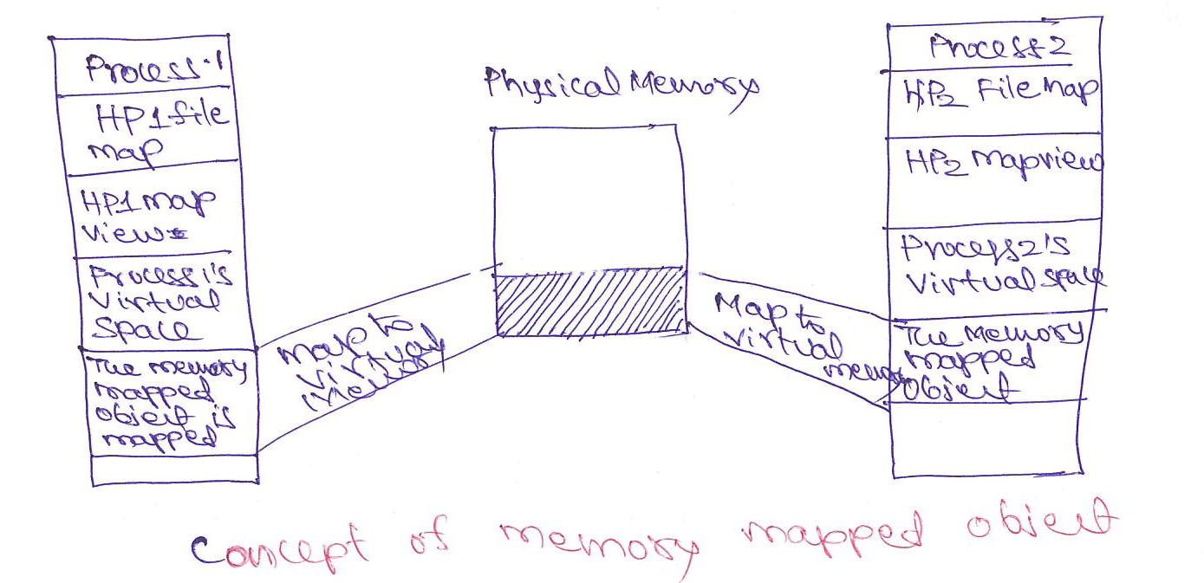

Slide 13
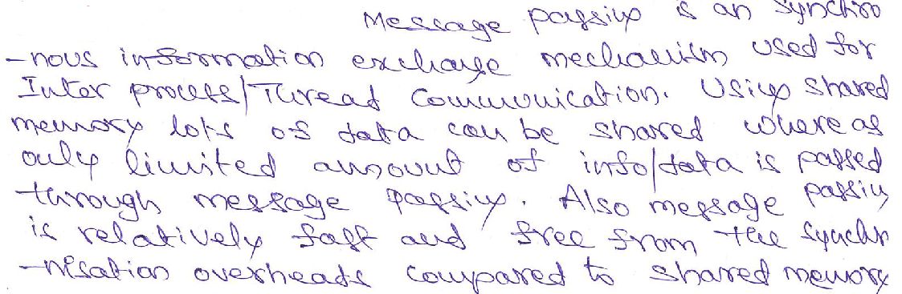
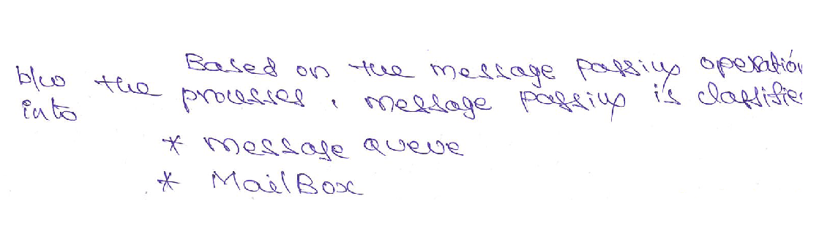
Message Passing

Slide 14
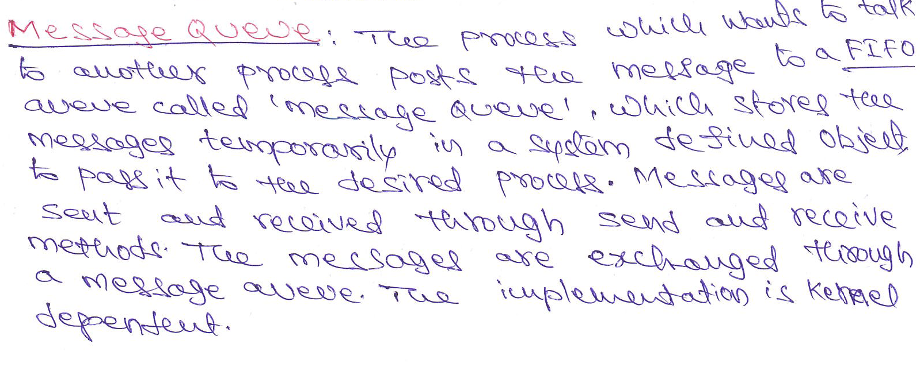
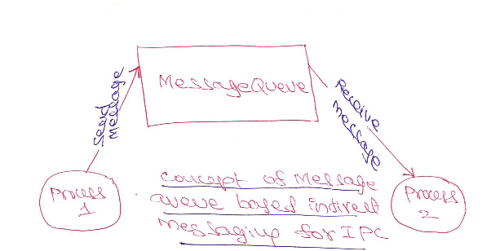
Message Queue

Slide 15
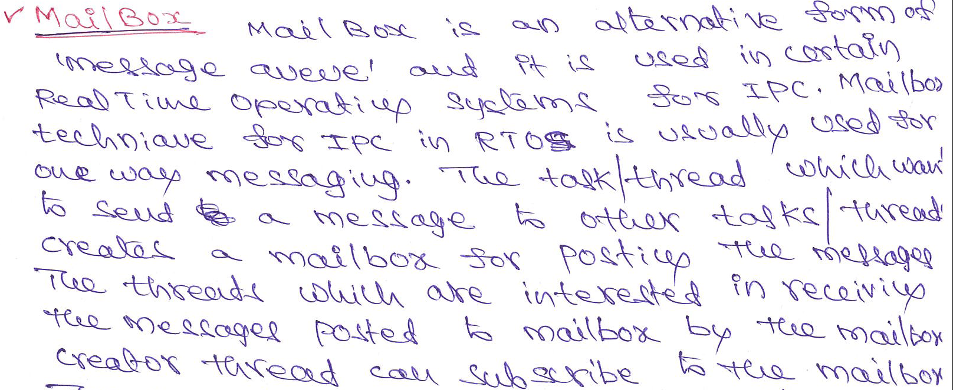
Mail Box

Slide 16
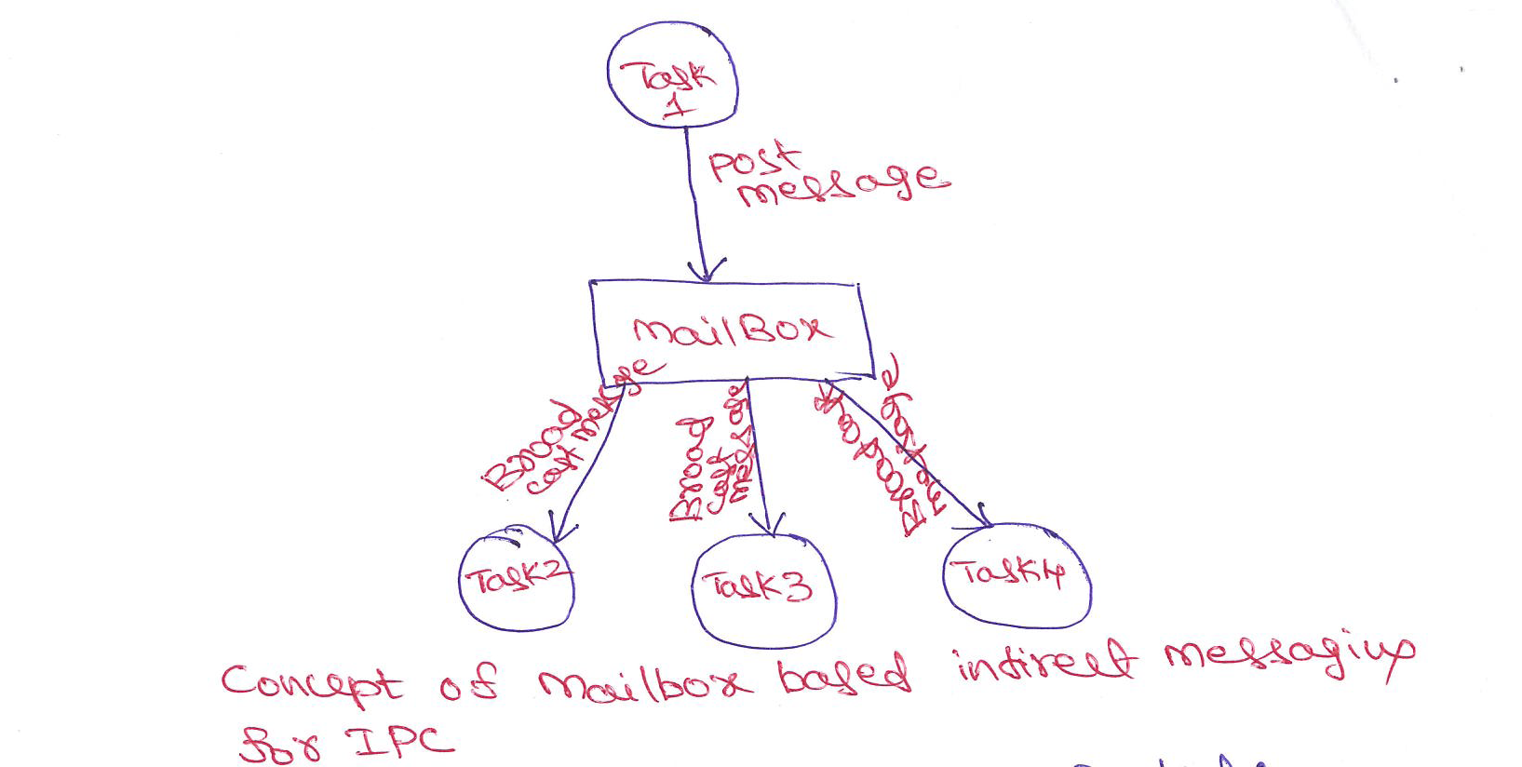

Slide 17
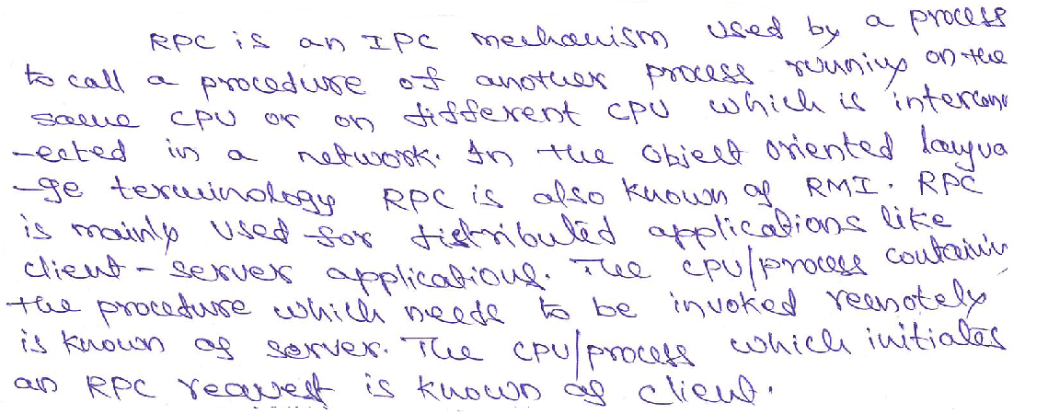
Remote Procedure Calls ( RPC )

Slide 18
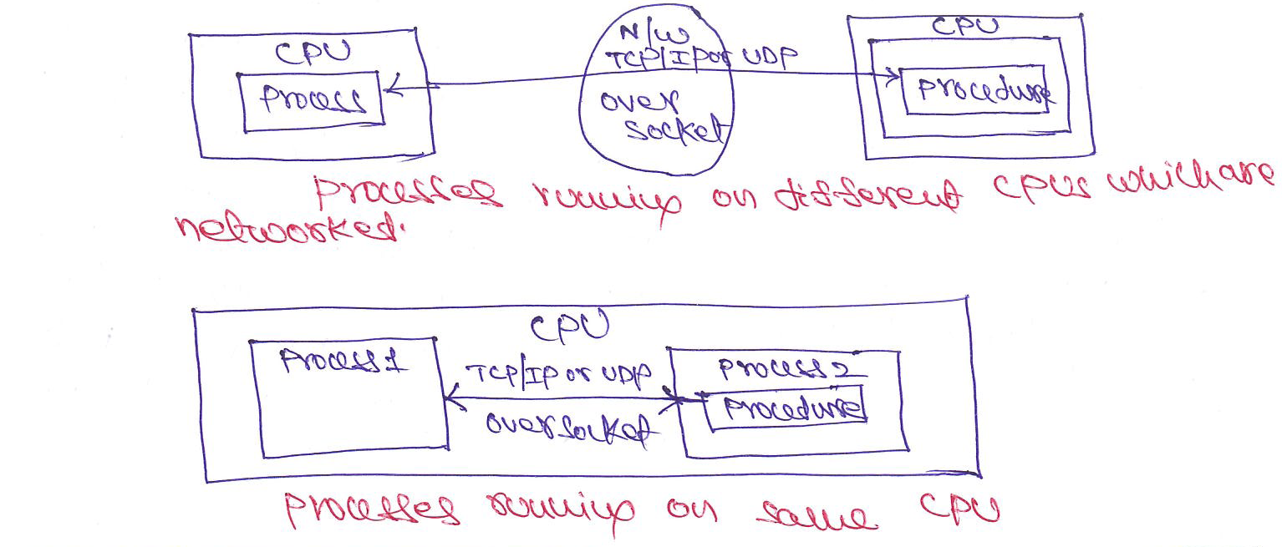

Slide 19
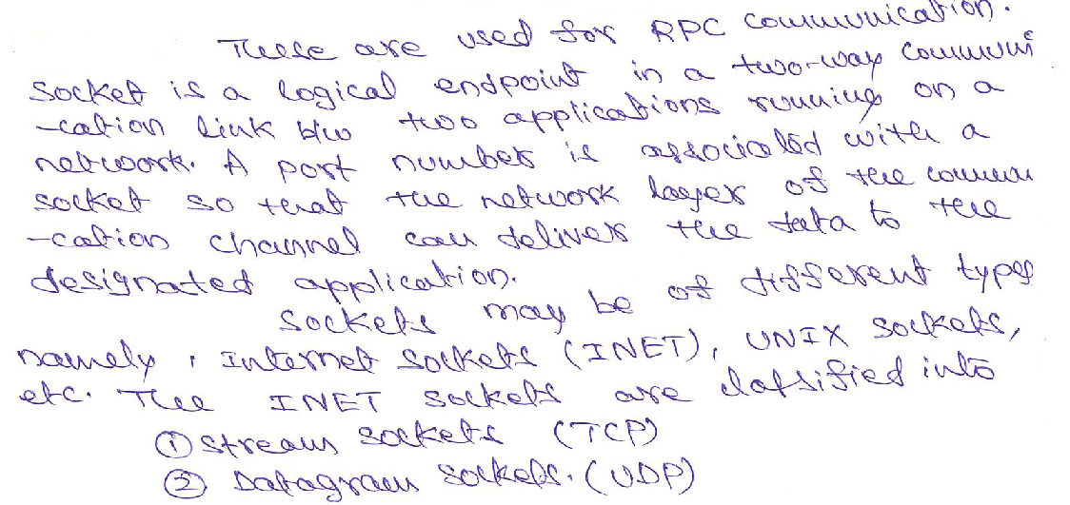
Sockets

Slide 20
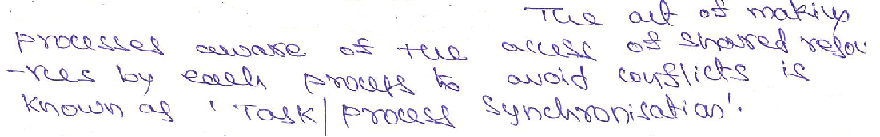
Task Synchronization

Slide 21
Task Synchronization Issues
Racing
Dead Lock
Live Lock
Starvation

Slide 22
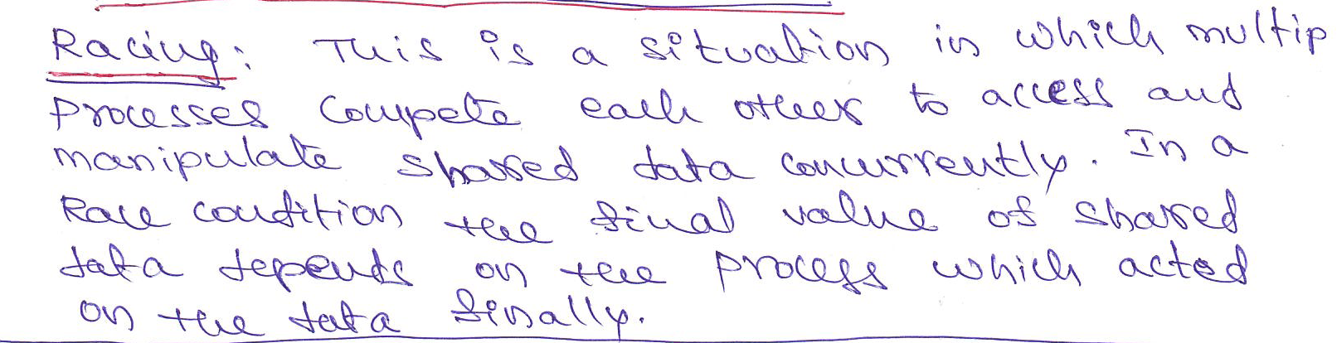
Racing

Slide 23
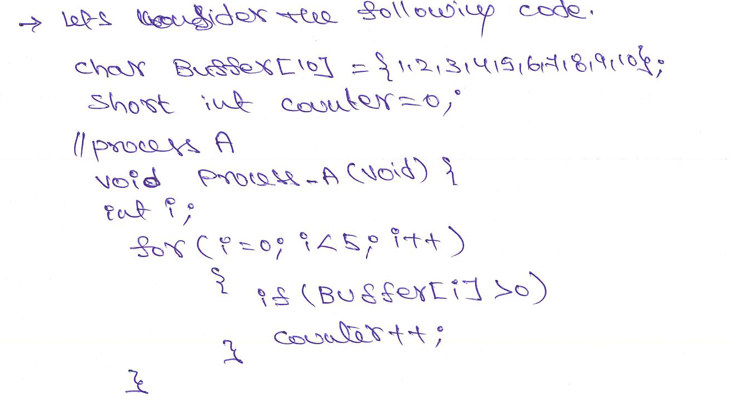

Slide 24
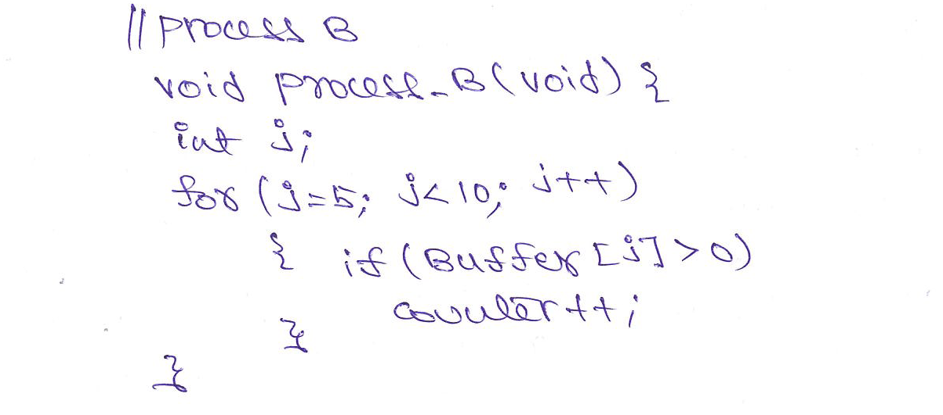

Slide 25
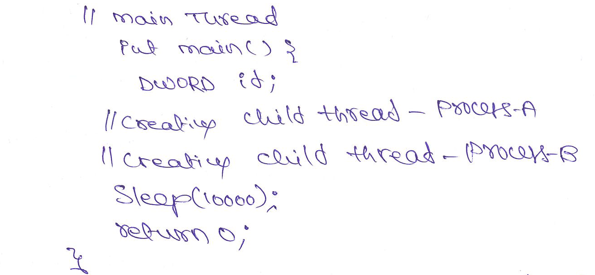

Slide 26
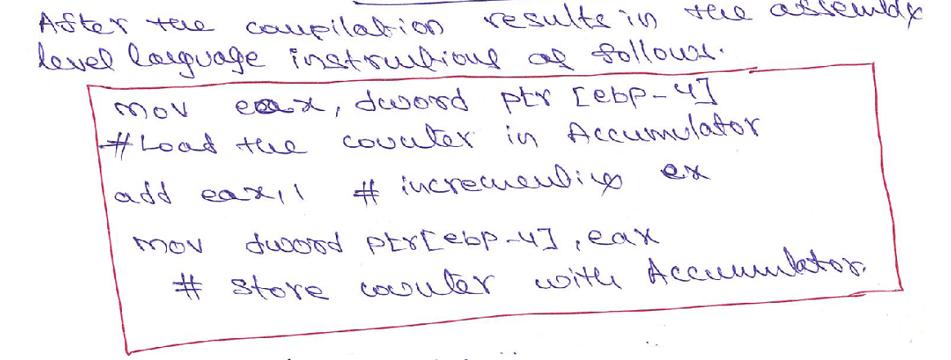

Slide 27
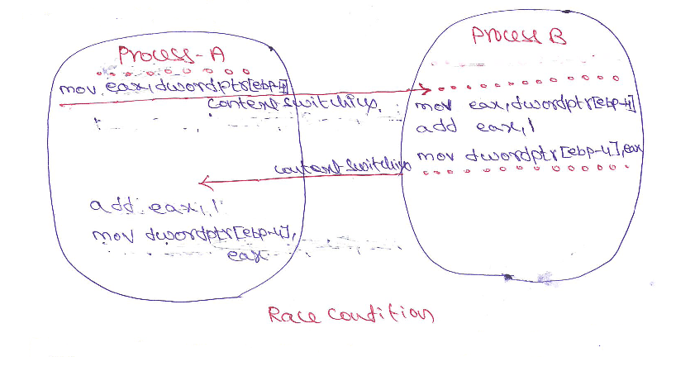

Slide 28
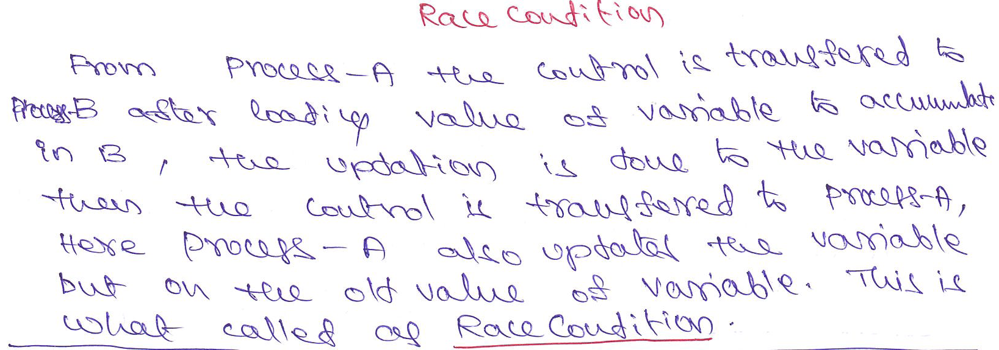

Slide 29
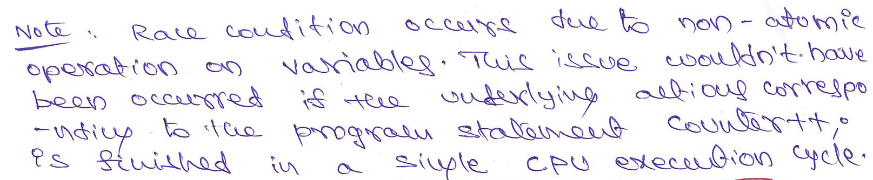
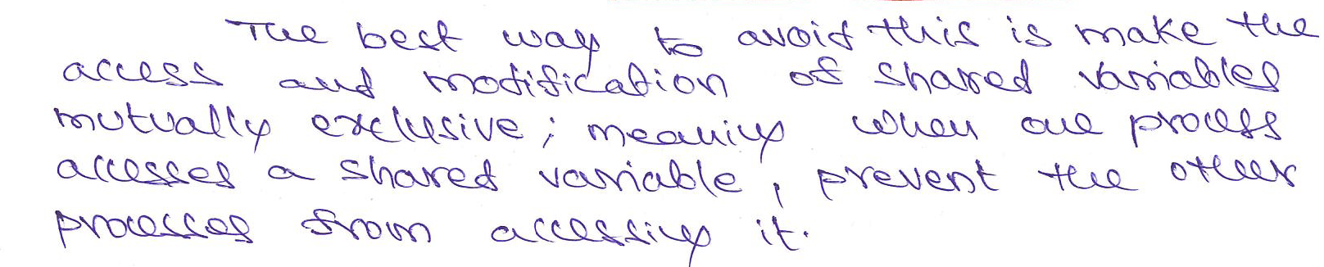

Slide 30
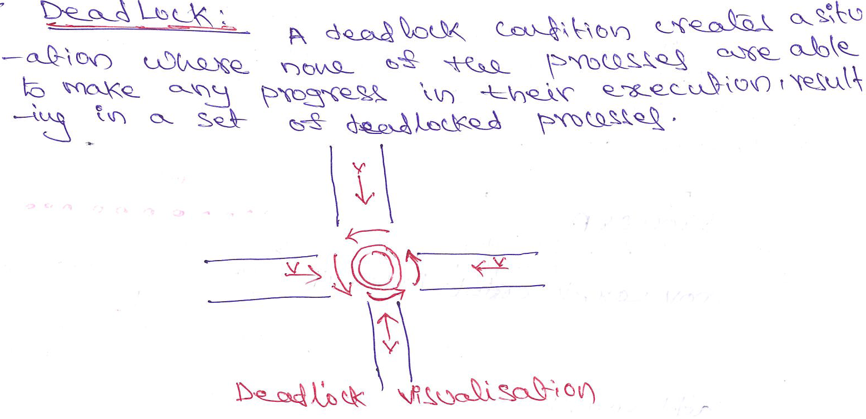
Dead Lock

Slide 31
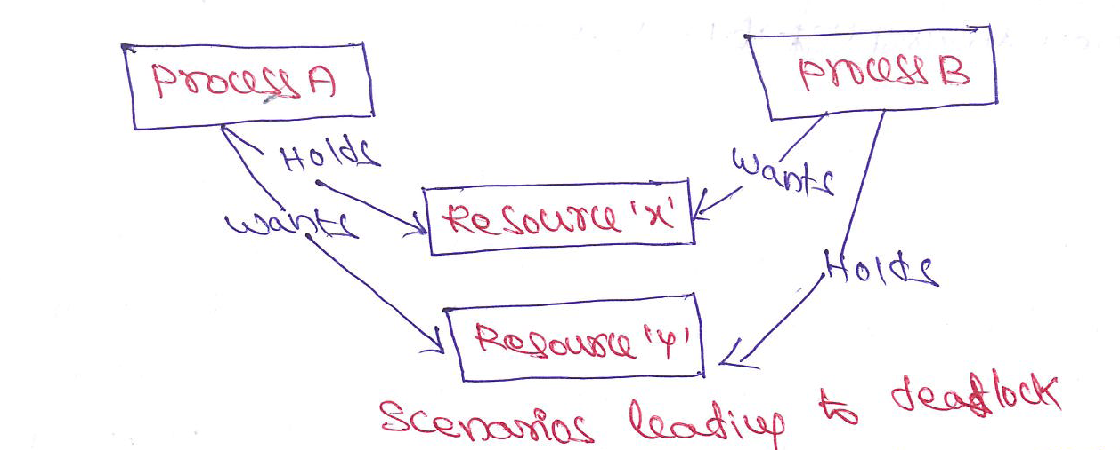
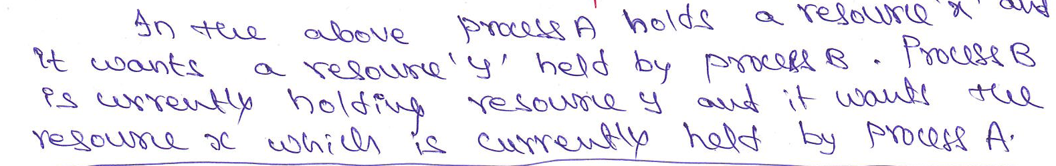
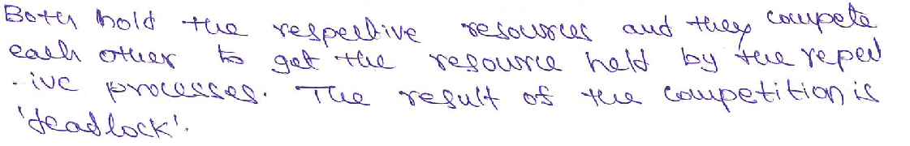

Slide 32
Conditions favoring Dead Lock situations
Mutual Exclusion
Hold and wait
No resource Preemption
Circular Wait

Slide 33
Dead Lock Handling
Ignore Dead Lock
Detect and Recover
Avoid Dead Locks
Prevent Dead Locks

Slide 34
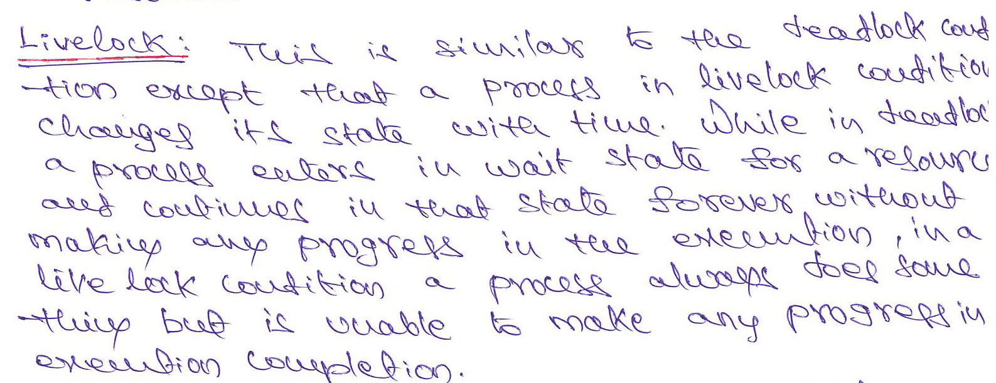

Slide 35
